Slide 1
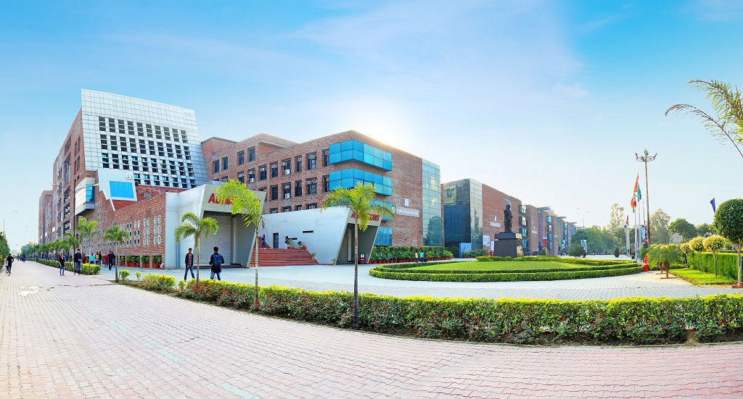
Idealized Community development
LOVELY PROFESSIONAL UNIVERSITY
M . Nischal
(11805850)

Slide 2
Contents
About NGO
How?
Aspects we covered
schools
Blood donation Campaigns
Conclusion
What ?

Slide 3
Introduction about NGO:
AASRA is working with rural Women Groups, Weaver Community, youth & Individual Entrepreneurs, Tribal and Sections amongst backward communities.
AASRA also plans extend its operations to remote tribal villages and reach medical, drinking water and modern farming programmes for their betterment.

Slide 4

What?
•To Aware People
• Development in all aspects
•Change in thinking
•Solve Community Problems
Notes:
Consider talking about:
CED in the US
CED around the world

Slide 5

How?
To aware the people:
The main object of community development is working to make various problems in a community.
Development in all aspects:
It helps to know about the main cause affects their social life. It seeks the opportunities better living standard of the community people.
Solve community problems:
There are many ways for Community Problem Solving, can solve by discussions.

Slide 6
Aspects we covered
Helping poor people with their needs in hospitals.
Educating children towards hygiene and sanity.
Maintaining clean locality.

Slide 7

Schools
learning & development: The purpose of community learning and development is to develop the capacity of individuals and groups of all ages through their actions, the capacity of communities, to improve their quality of life , to lead better.
And we also educated them and explained how to be in the time of menstruation period.

Slide 8
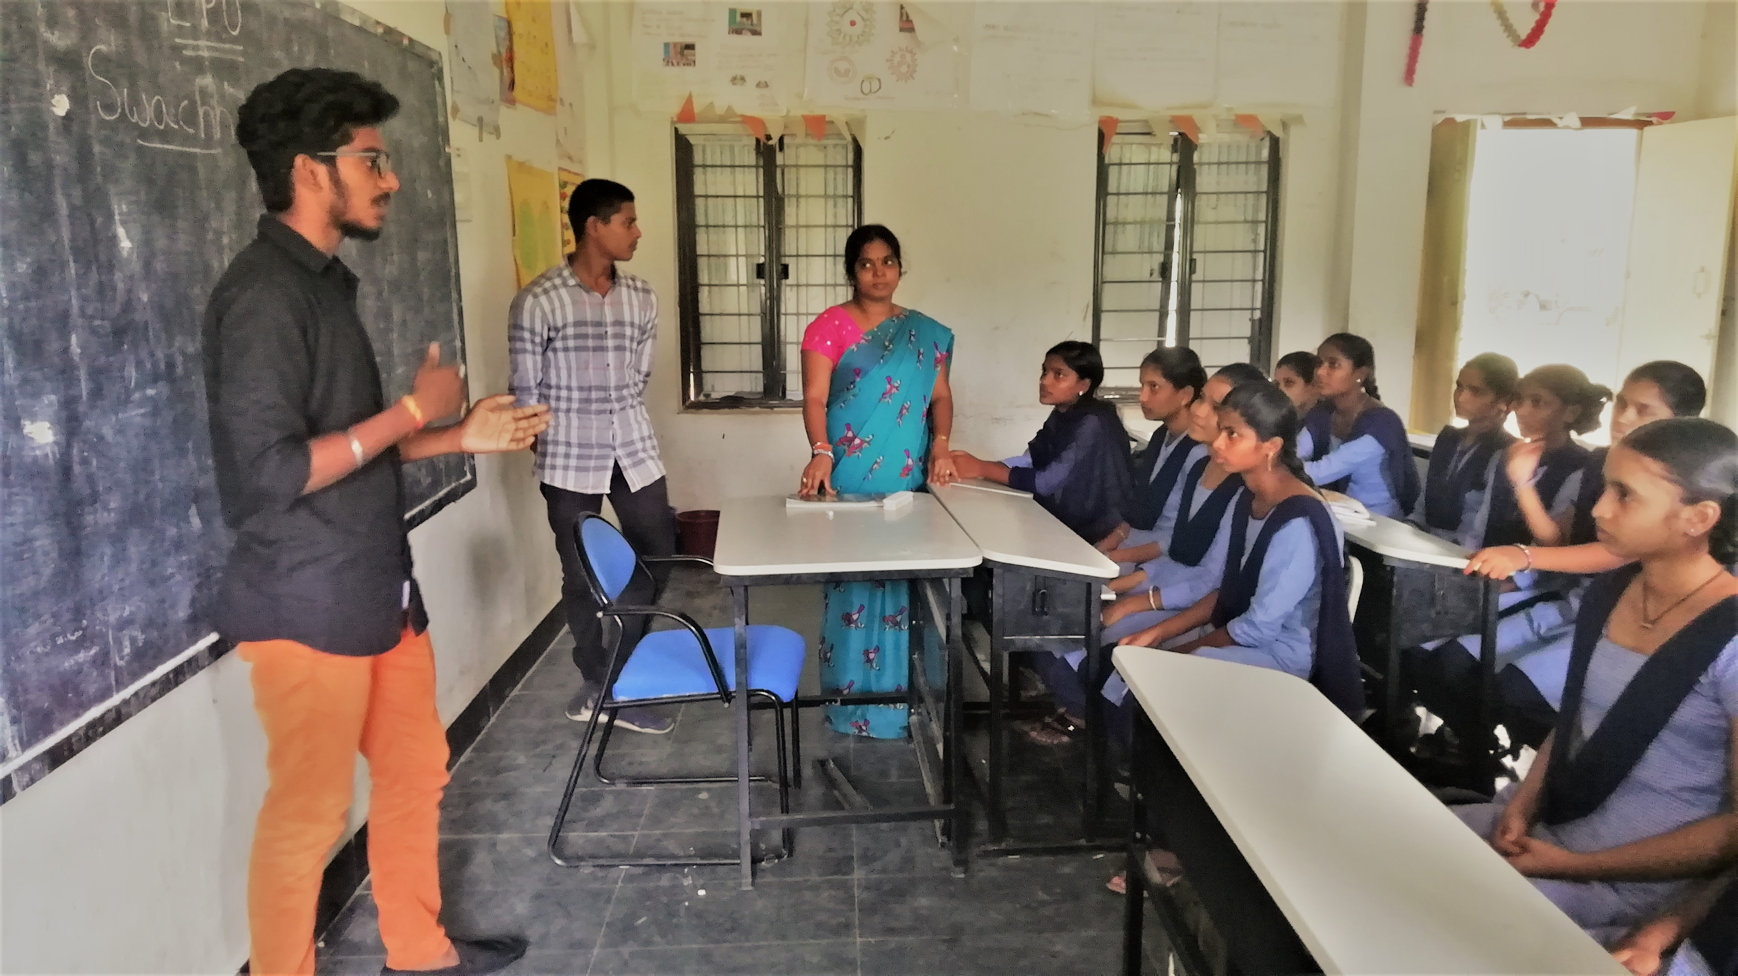
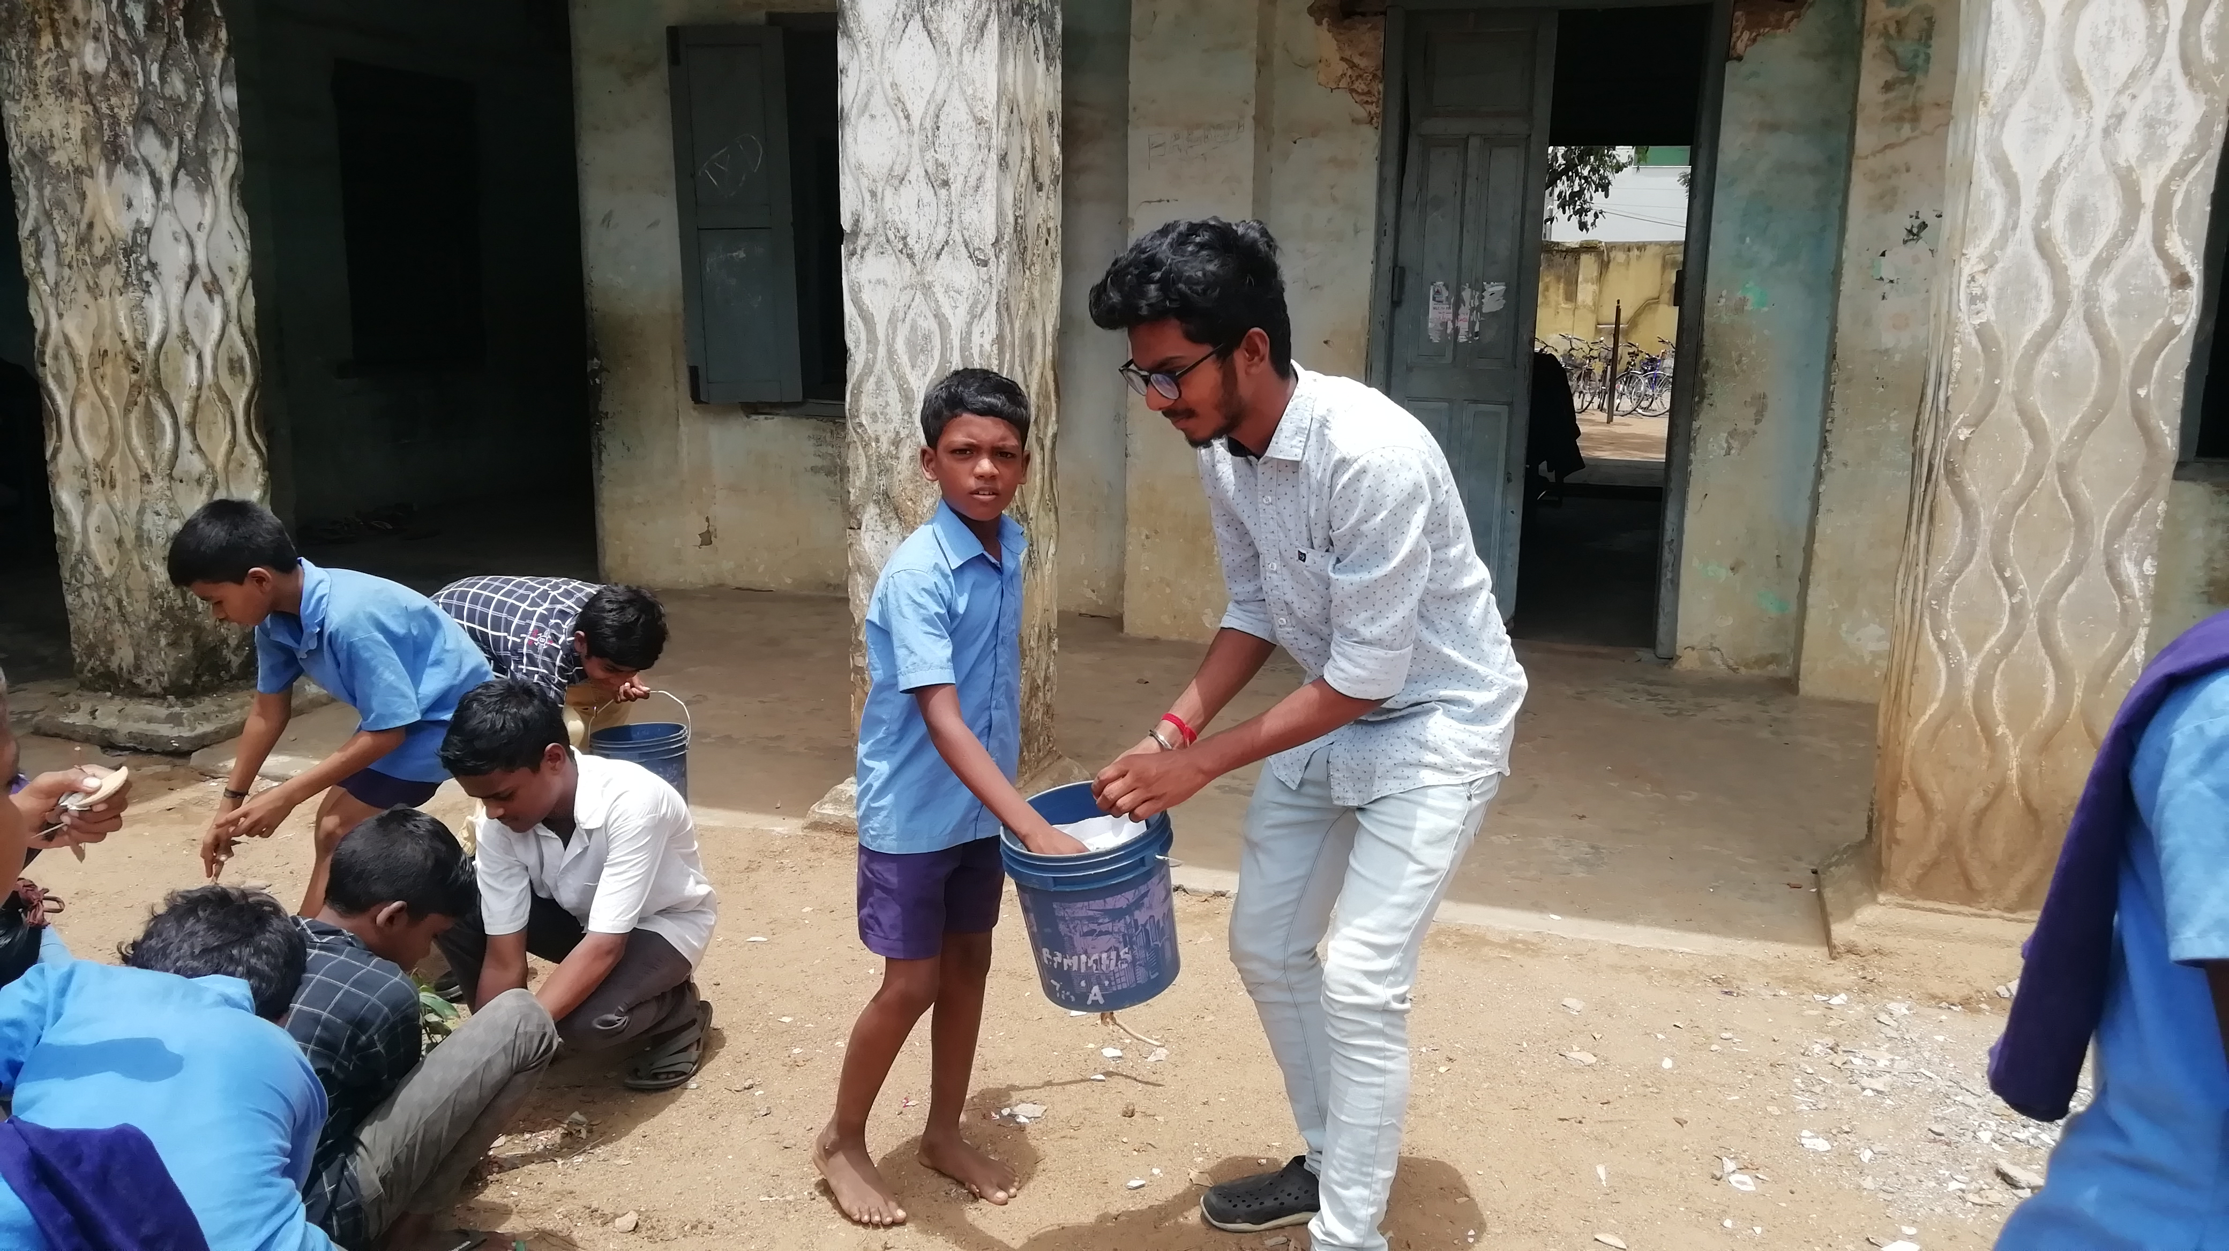
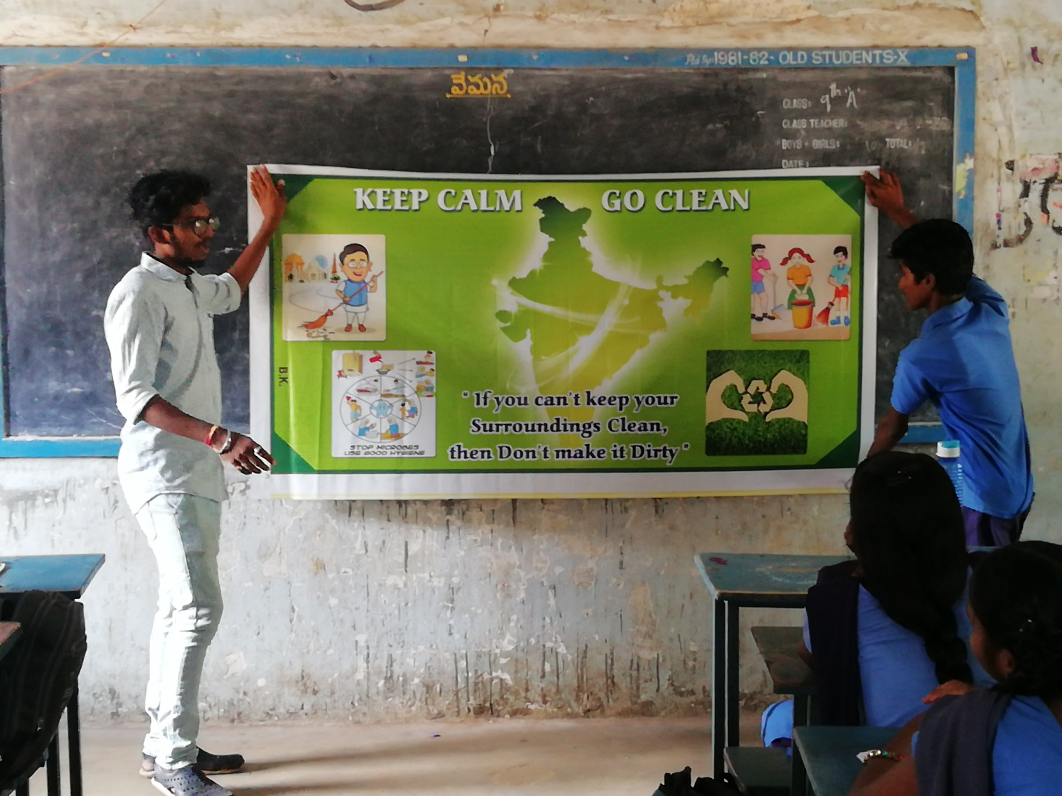
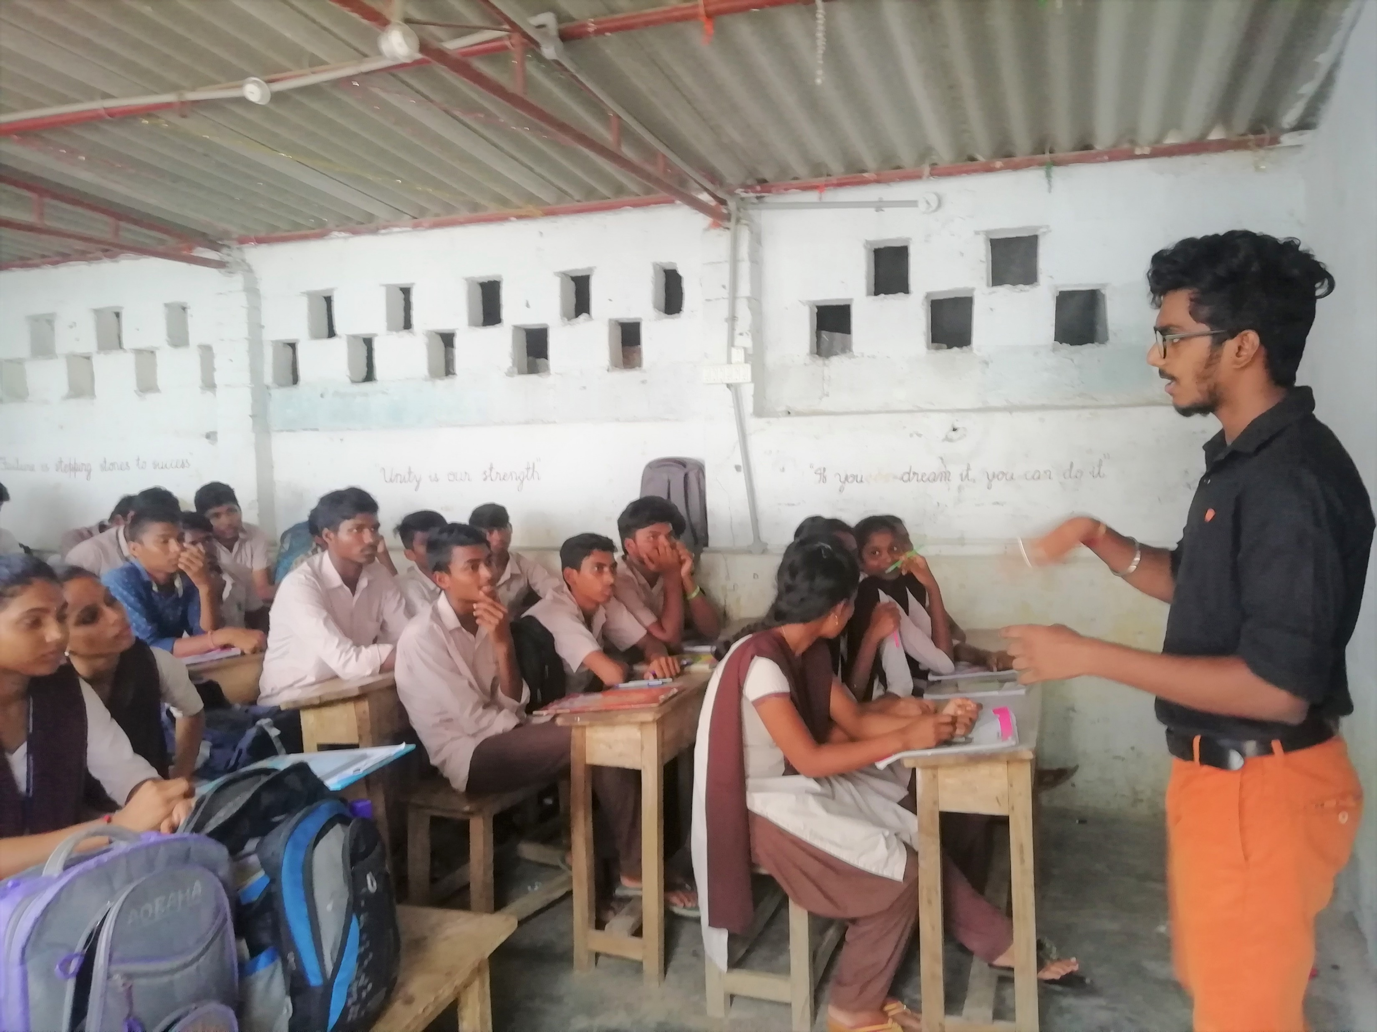

Slide 10
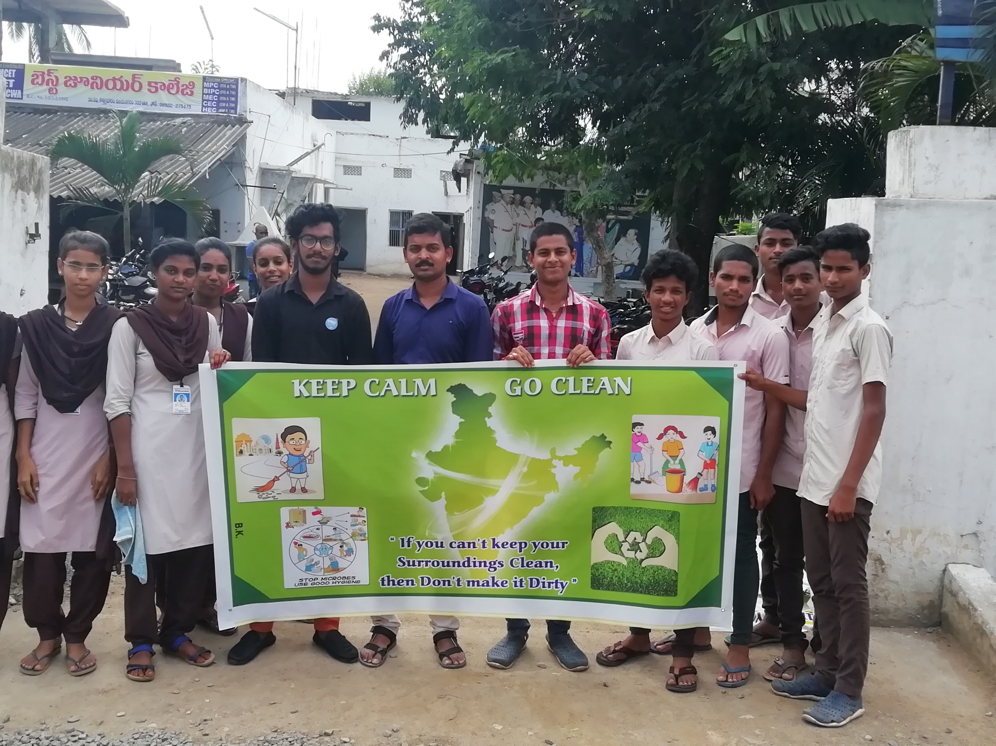
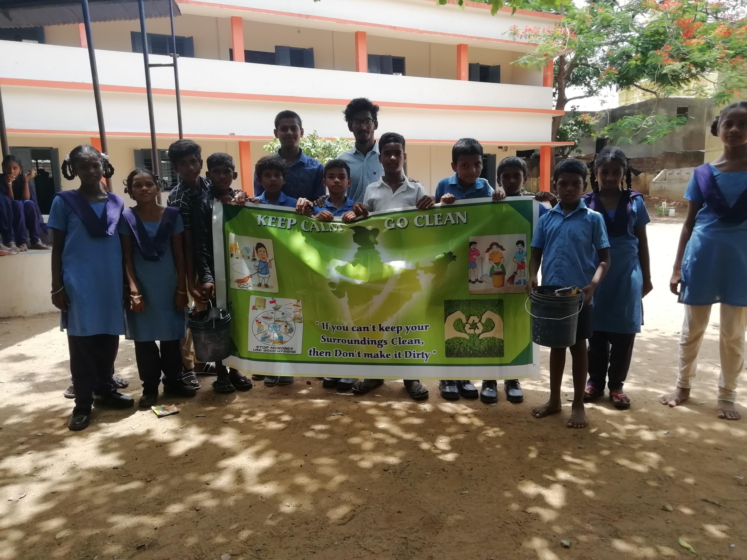
Schools And Colleges that we took part

Slide 11

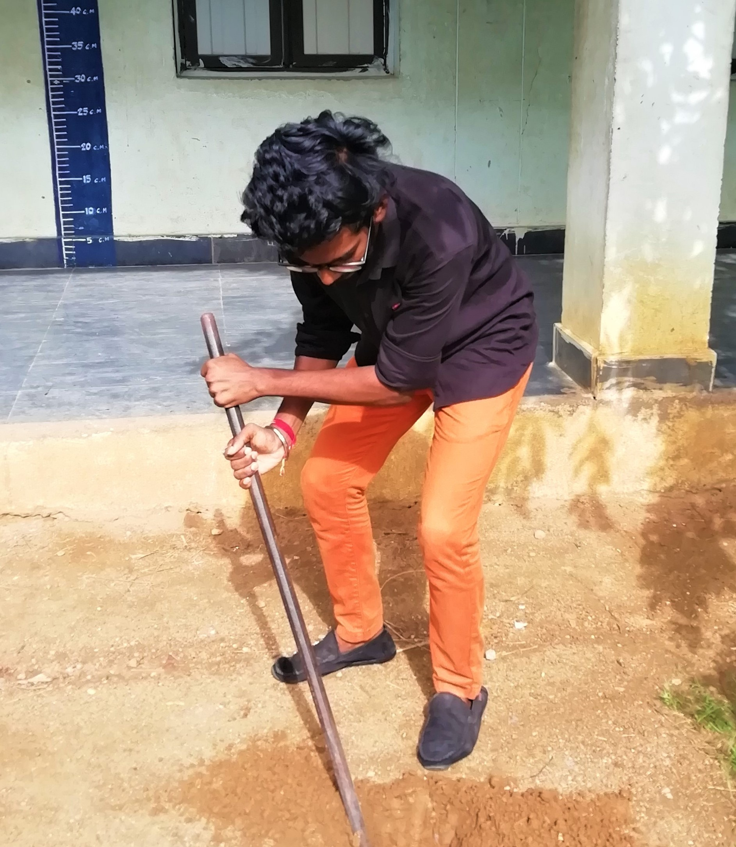
•All we went to some schools and installed some plants with the help of children’s. •And the management also join with us to make it successful. •And we explained about importance of plants are going to take part in future.
Planting plants

Slide 12

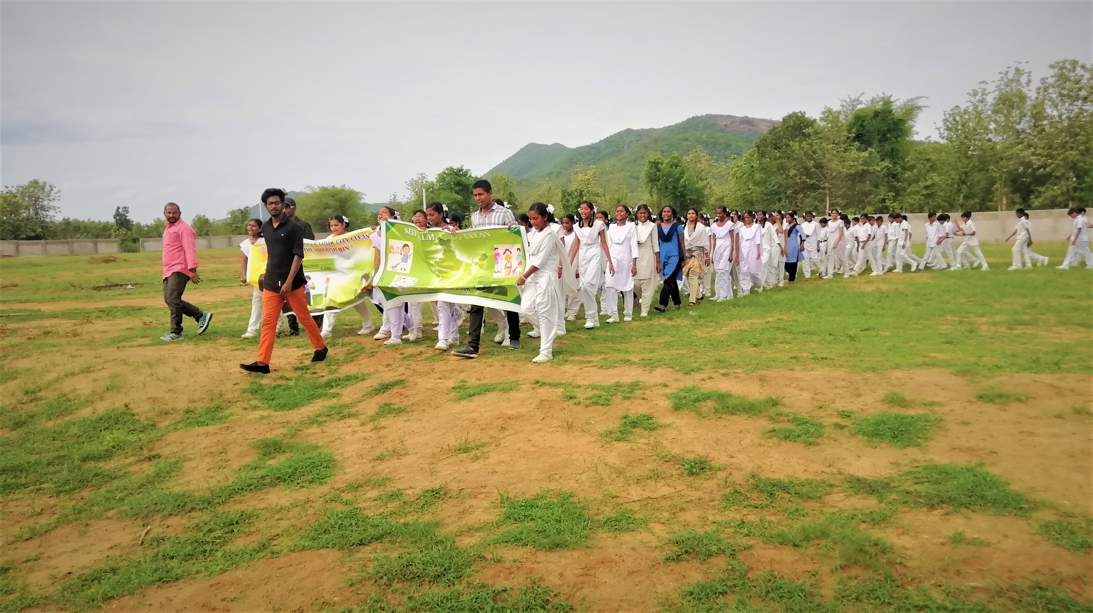
Conducted Rallye’s
We thought that only educating is not enough.
So we made some Rallies along with giving lectures.
Along with us some of our village officials also joined with us and made it successful.

Slide 13
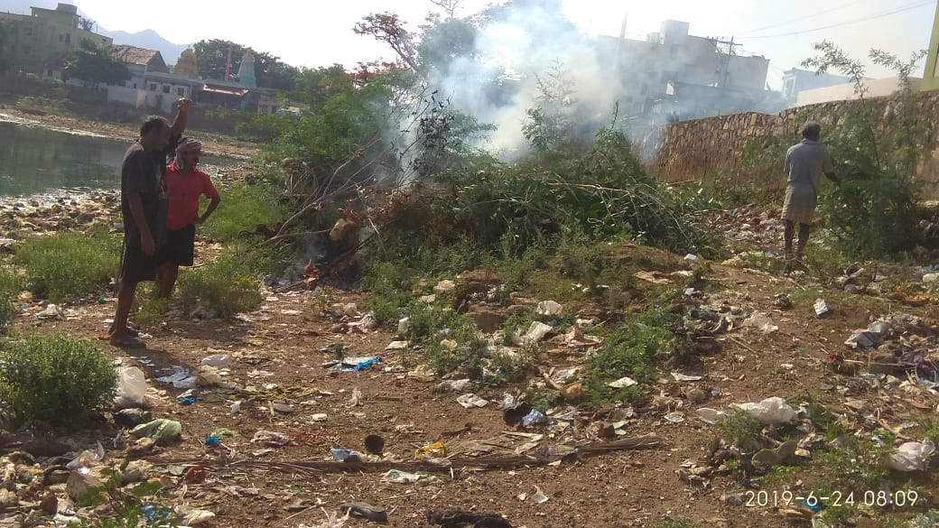
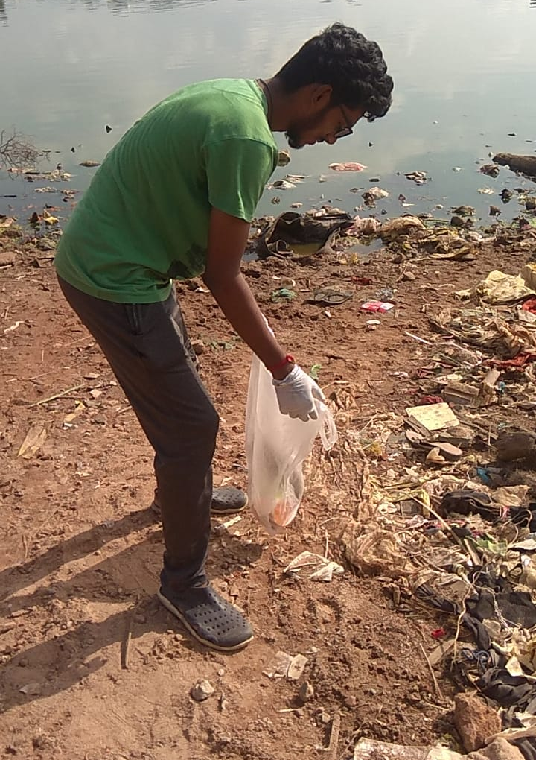
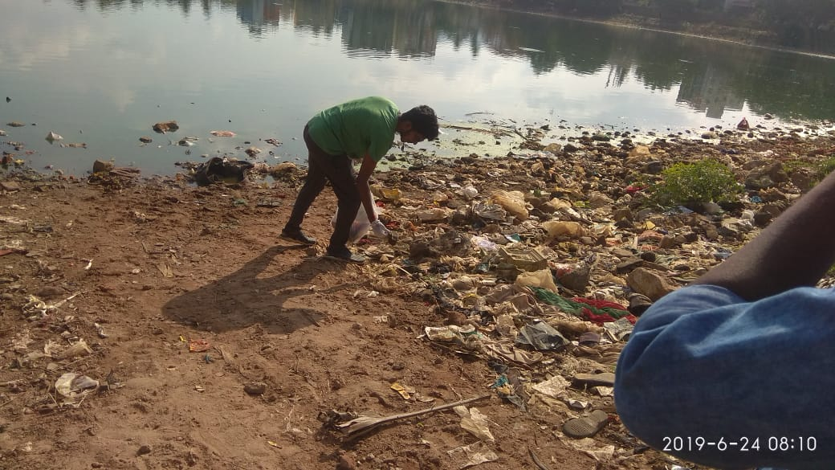
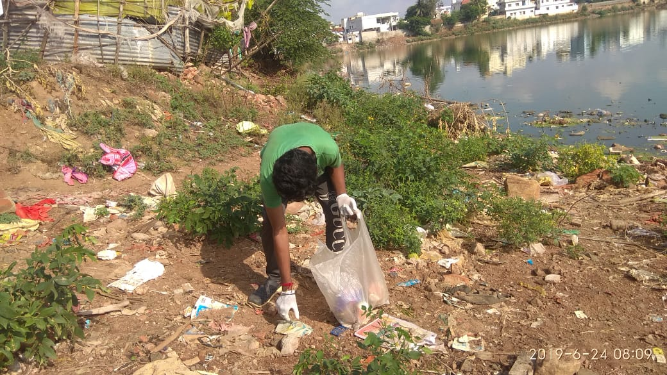
Cleaning our local pond

Slide 14
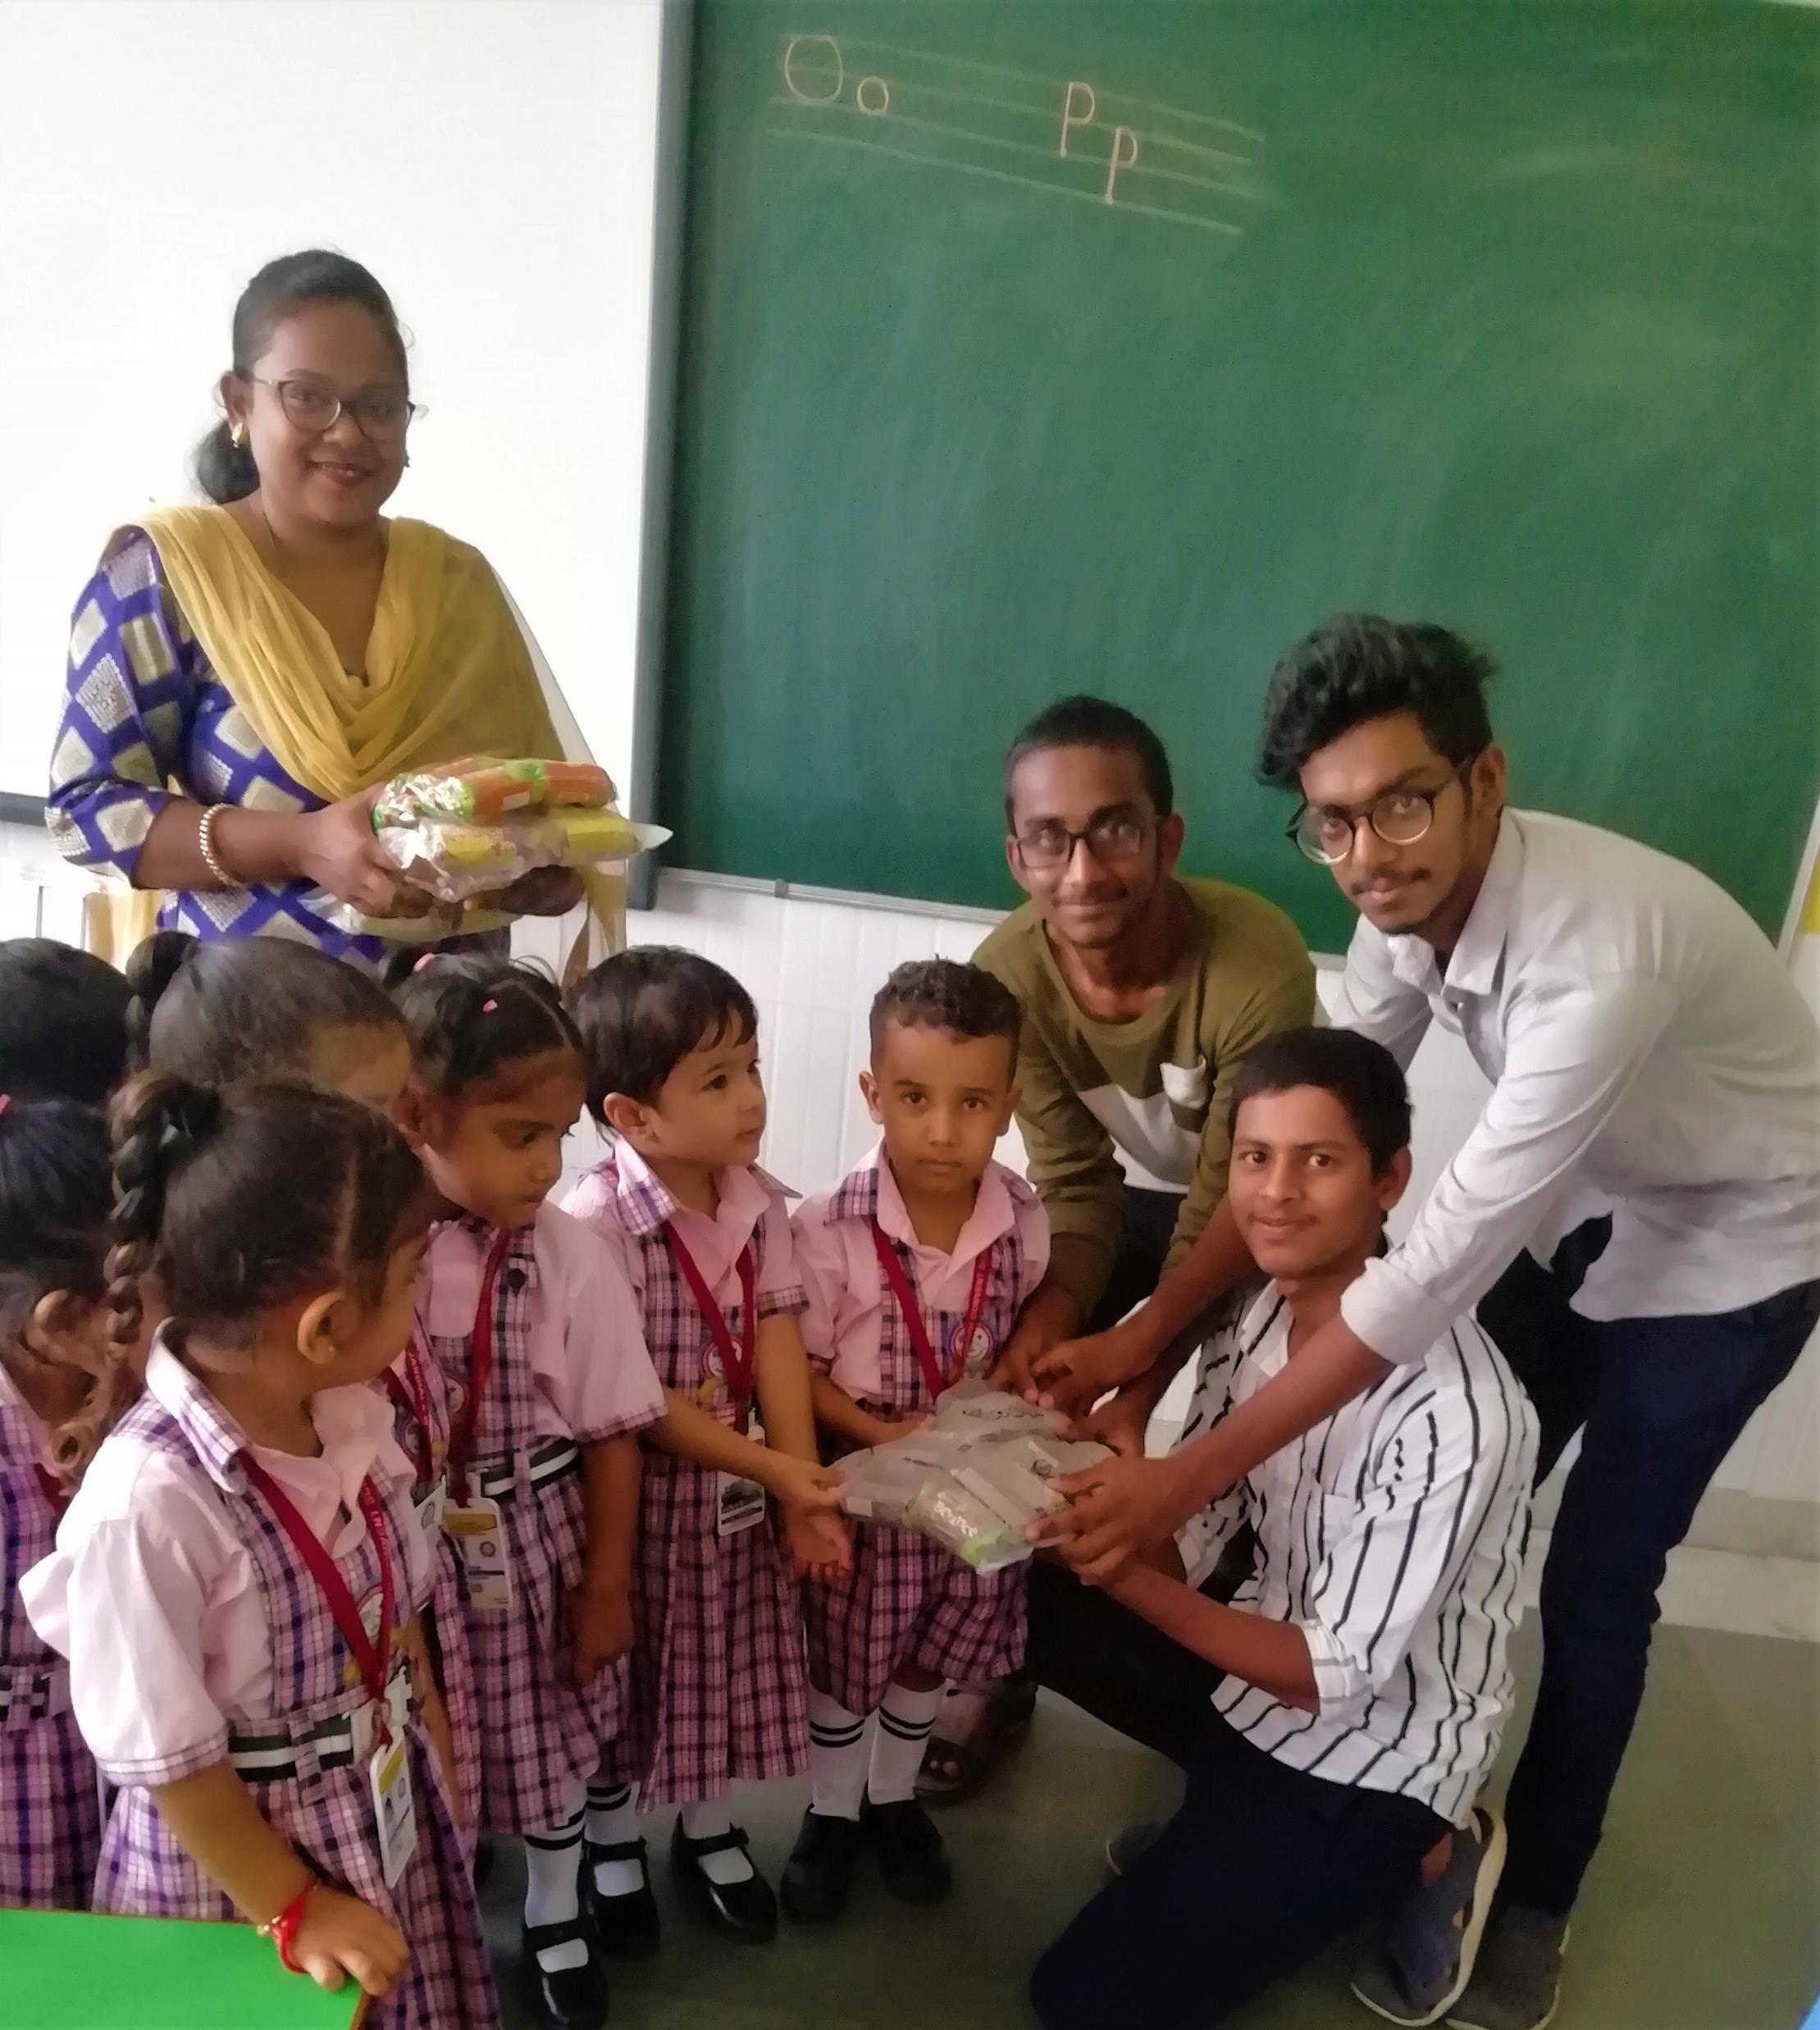
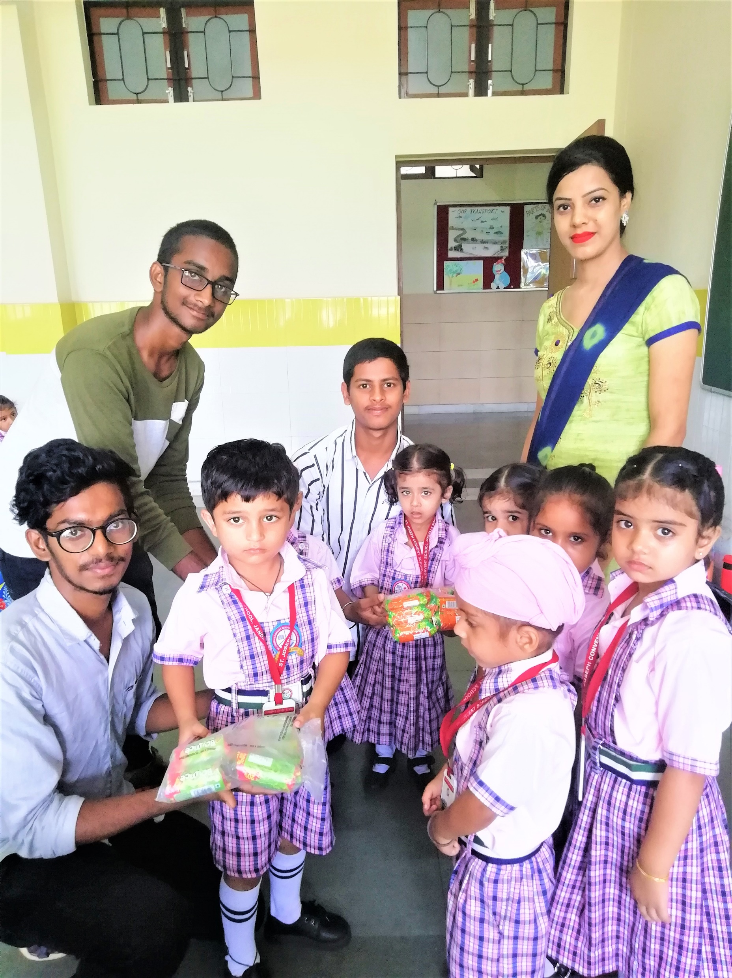
Distributing candies to pre-primary children

Slide 15

Blood donation campaigns
Most of these days some of the people losing life with scarcity of certain blood.
So we even took part in some blood donation campaigns
We heartfully participated in those campaigns through out it.

Slide 16
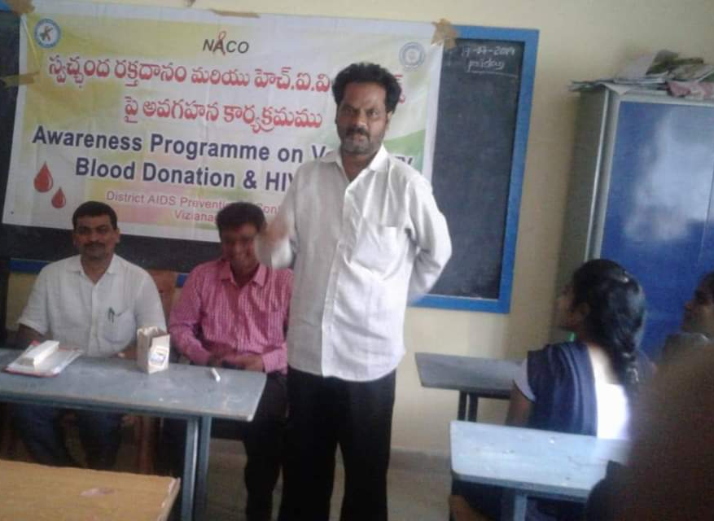
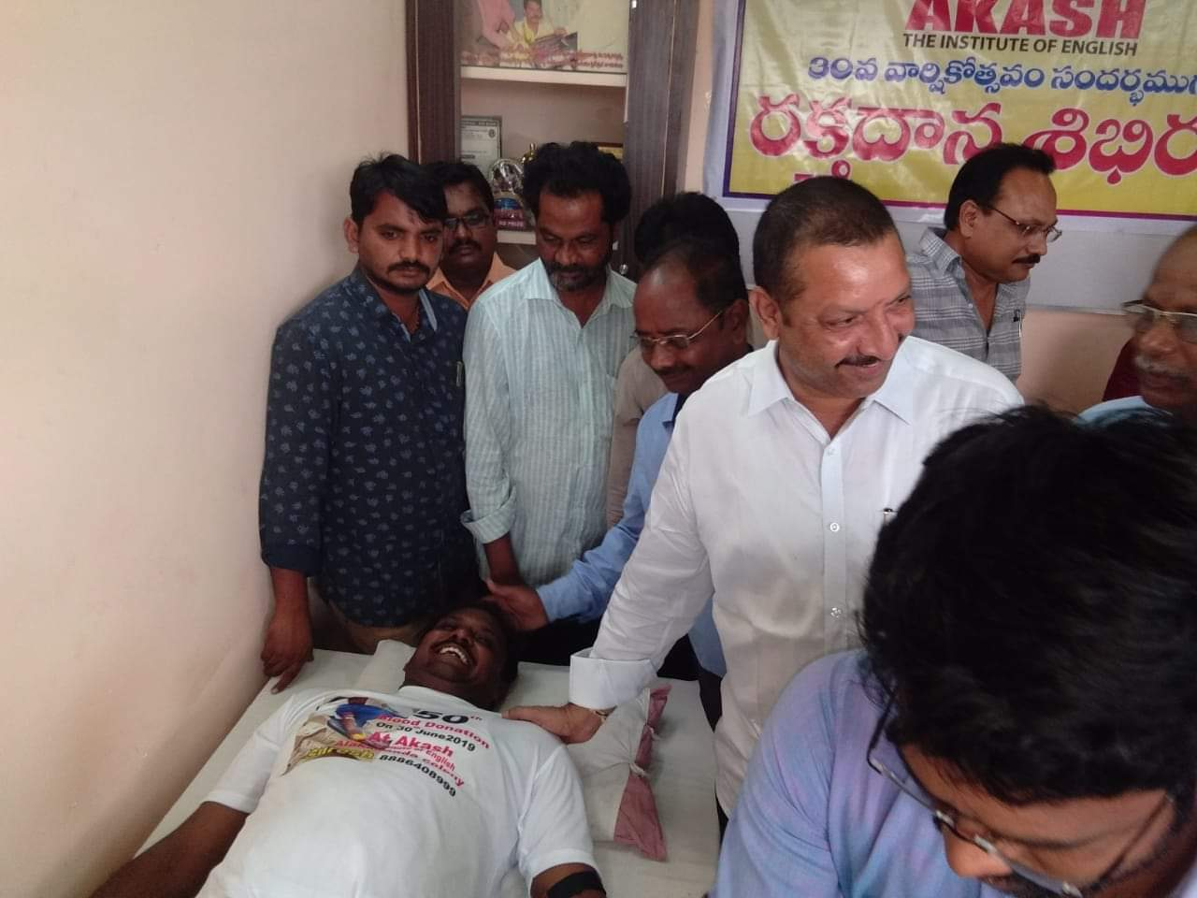
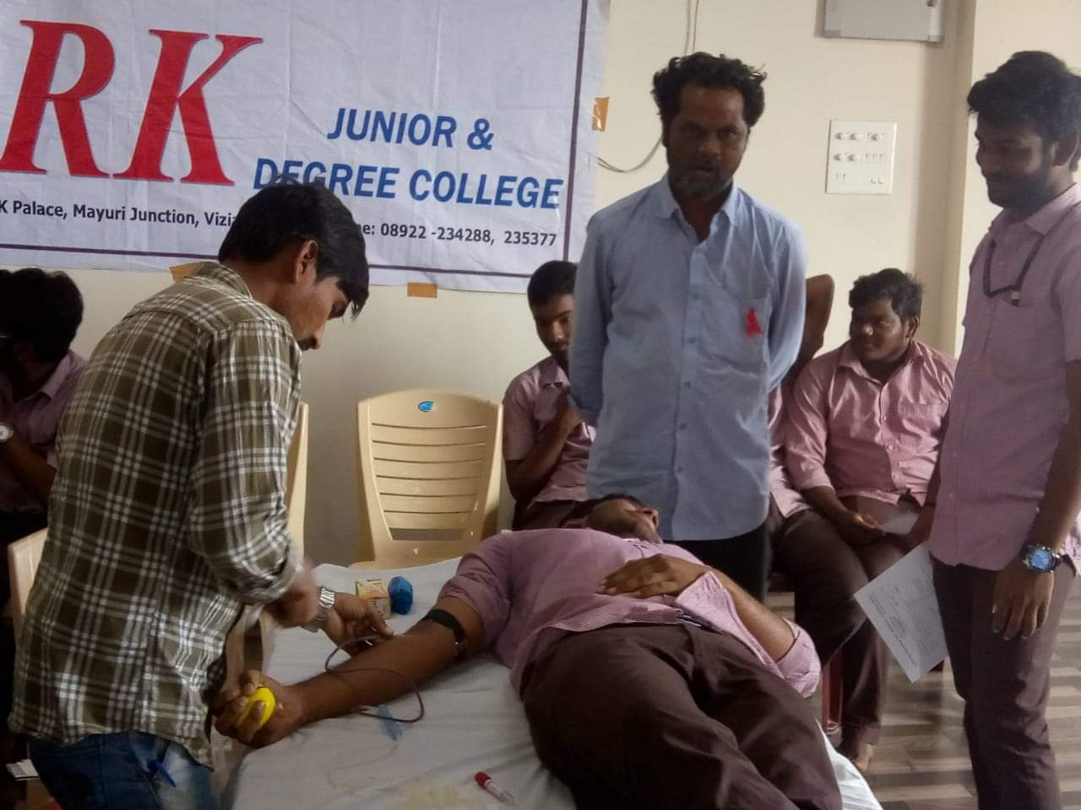
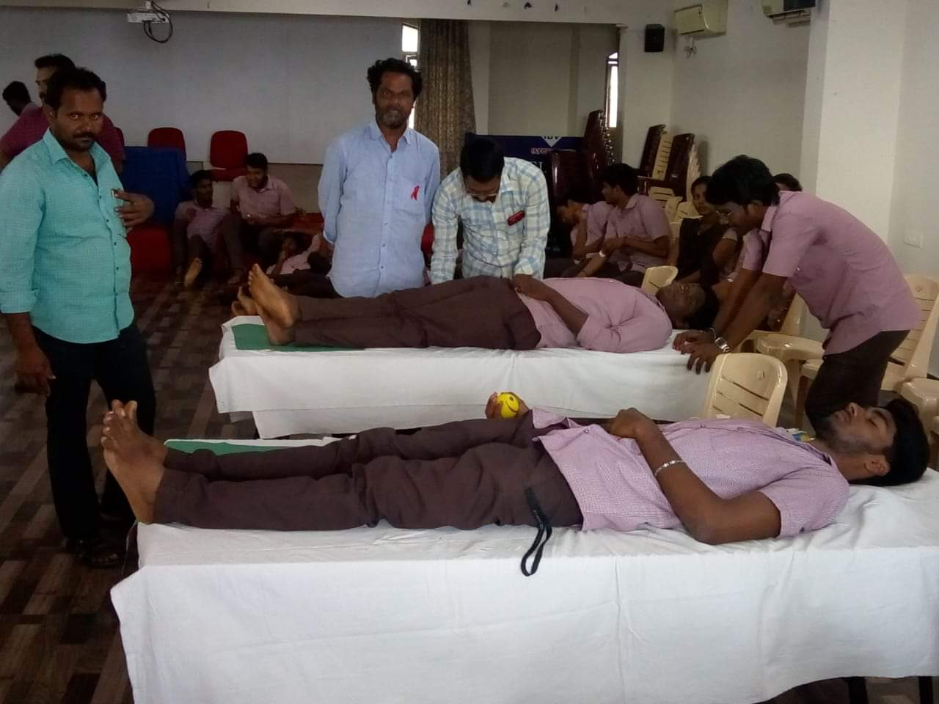
Motivating college students towards blood donation

Slide 17



We all did our best performance towards the work and hopefully enjoyed the work.
Finally I conclude that we had solved some issues and gave some knowledge for the future ones.
behind all the work all we had a support by our officials and my team mates.

Slide 18

Thank you

